Slide 1
Rhinoviruses & their molecular classification
Martha Luka
06 Feb 2024

Slide 2
Rhinovirus
Highly prevalent in the human population.
Associated with:-
Common cold
Asthma/wheezing and COPD exacerbations
Sinusitis
Bronchitis and LRTIs
Notes:
Icosahedral structure. Capsid proteins (VP1-4)
Spread through inhalation of contaminated aerosols and close personal contact

Slide 3
Rhinovirus
Highly prevalent in the human population.
Associated with:-
Common cold
Asthma/wheezing and COPD exacerbations
Sinusitis
Bronchitis and LRTIs
Positive-sense, ss RNA viruses (Family: Picornaviridae, Genus: Enteroviruses.
3 species: A, B & C .
169 types within the 3 spp.
7200 bp genome containing a single ORF.
Jacobs et al.,, 2013
Notes:
Icosahedral structure. Capsid proteins (VP1-4)
Spread through inhalation of contaminated aerosols and close personal contact

Slide 4
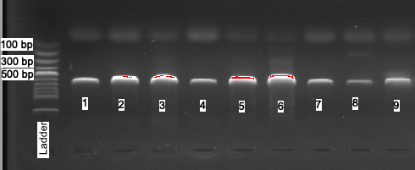
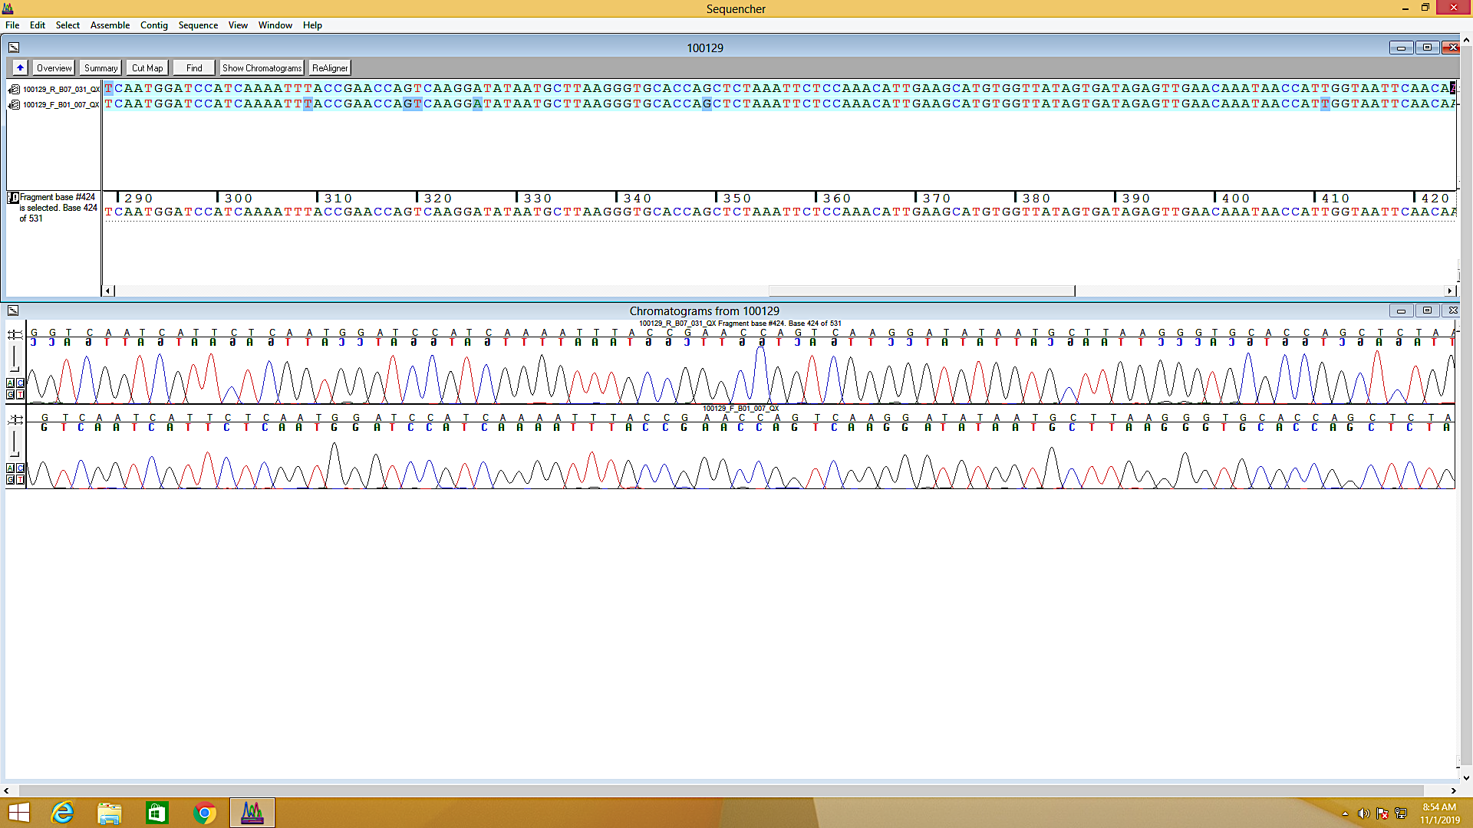
RV detection and sequencing
Nasal swabs were screened for HRV using RT-PCR.
VP4/2 amplification.
ABI 3130xl genetic analyzer.
Raw sequence reads QC, trimming and assembly.
Notes:
Sequencher version 5.4.6

Slide 5



Genotyping & genetic diversity
Multiple Sequence Alignment
MAFFT
Phylogenetic tree construction
IQTREE
Pairwise nucleotide p-distances
MEGA7
Scripting
HiLiter plots
Tree visualization and annotation
FigTree
Notes:
The BIC accounts for the length of the sequence (n) as well as the number of parameters
Tree inference models chosen according to BIC.
Type assignments

Slide 6
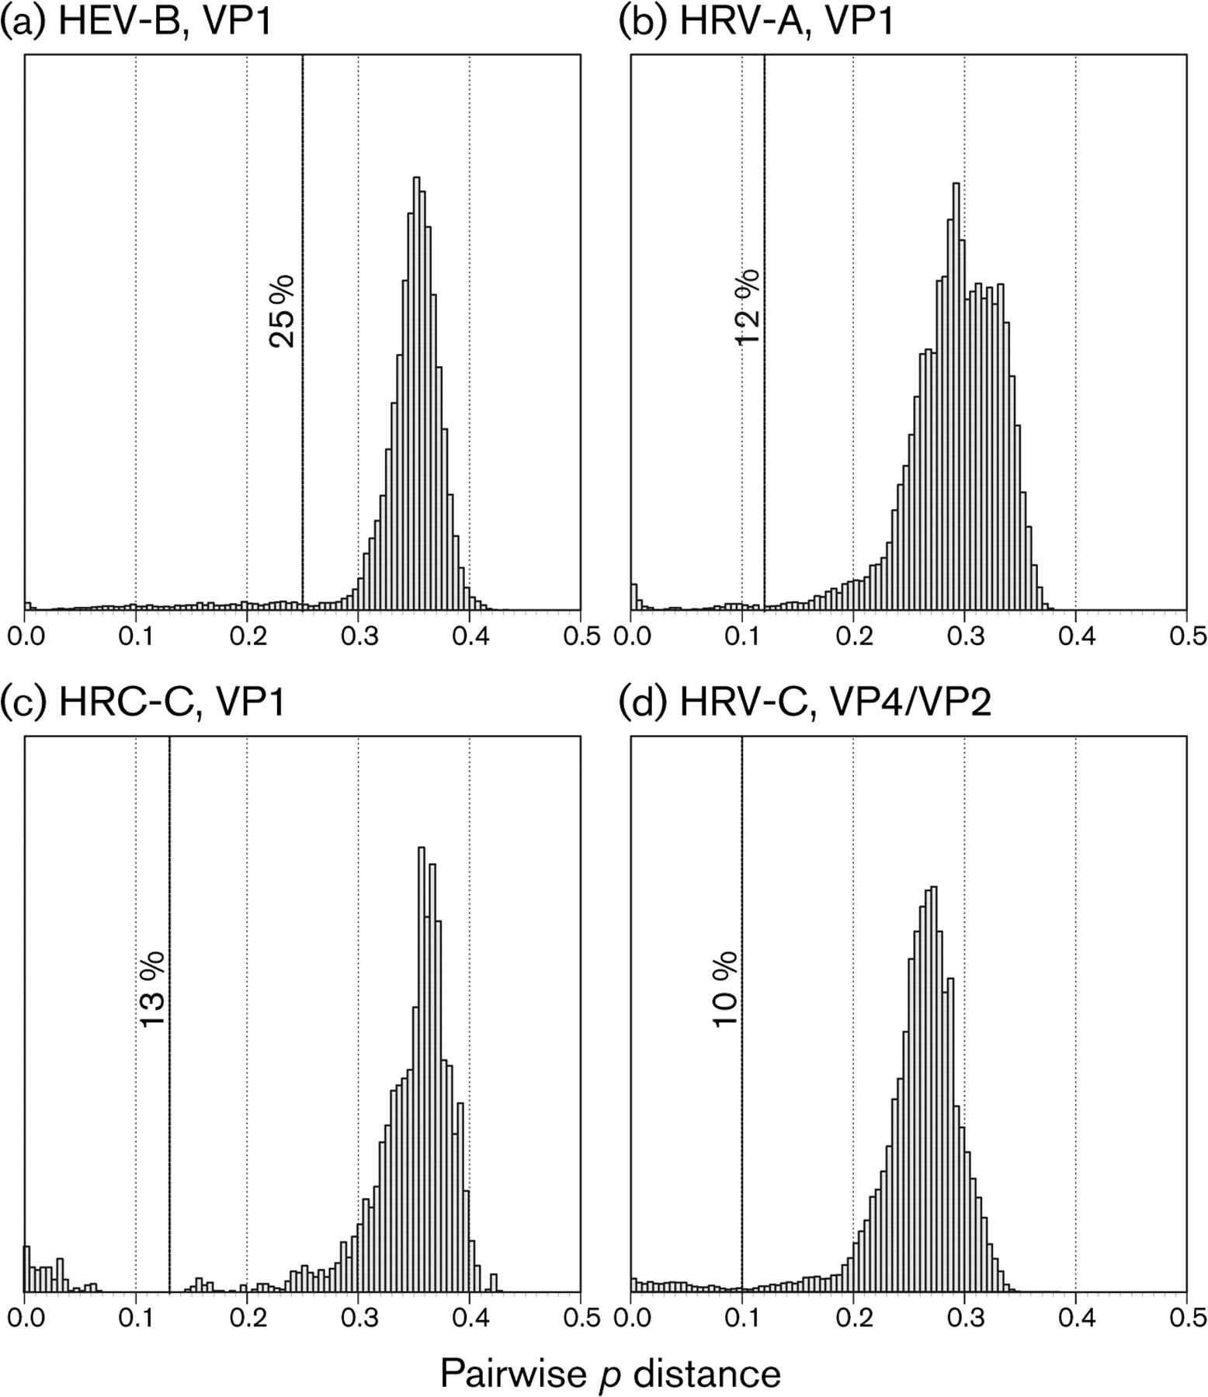
p-distance cut-offs
RV-A - 10.5%
RV-B - 9.5%
RV-C - 10.5%

Slide 7
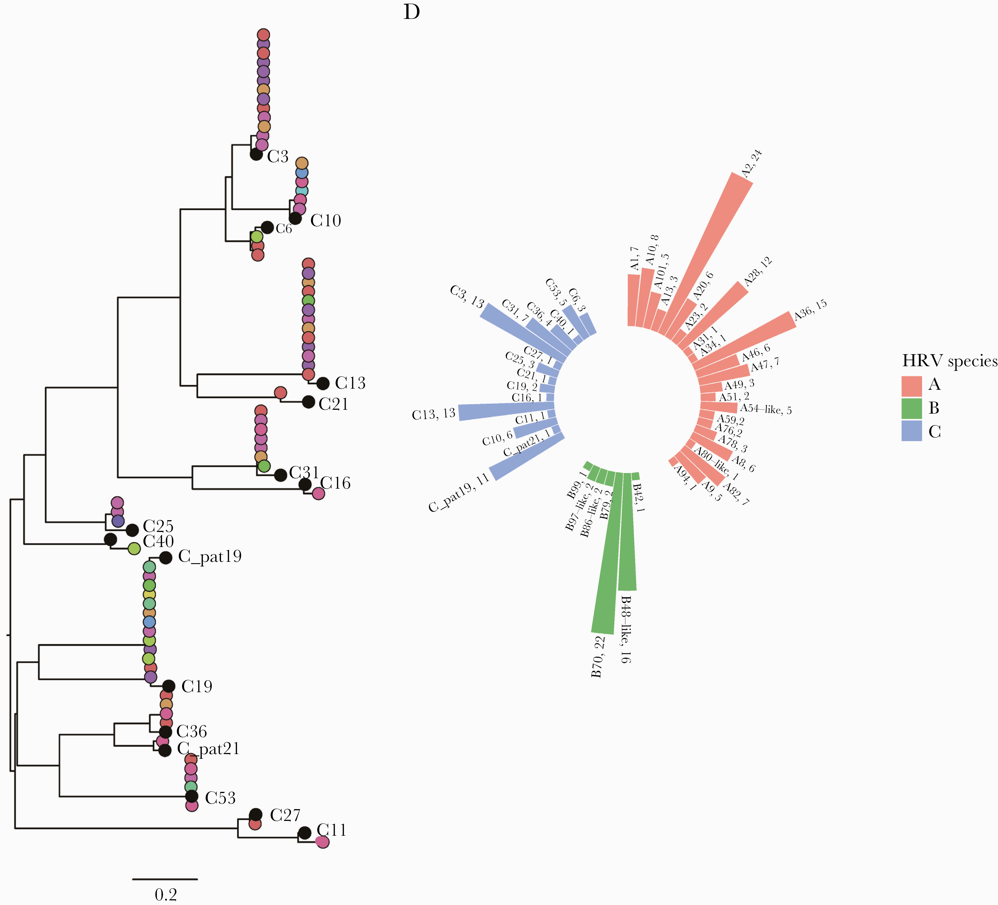
Phylogenetic clustering
Phylogenetic clustering to prototype/ ref strains
Visualization of diversity
Notes:
Circular bar plot with tips labelled: HRV type, frequency
45 known types, and 3 unassigned clades, the latter all in HRV-A.
25 unique HRV-A types, 7 HRV-B types, 16 HRV-C types
Some types were more frequent than others – B70, A2

Slide 8
Intra-type diversity
HRV-B70
HRV-A2
Notes:
A2
Partial genomic sequences may resolve intra-genotype diversity (not guaranteed)

Slide 9
Conclusion
Human rhinovirus circulating in abundance throughout year in communities.
Highly diverse set of types, particularly in younger age groups – important role in transmission within the community?

Slide 10


Acknowledgement
Supervisors
Prof. James Nokes
Dr. Charles Agoti
Everlyn Kamau
VEC Team

